Slide 1
WEB APPLICATION
INTRODUCTION

Slide 2
Loyola Stalin
17 years of experience
Solution Architect
Exposure in Product +Service industry
loyolastalin@gmail.com
Linked-in : loyolastalin

Slide 3
Agenda
Brief about Application Type
Web Application
Intro to HTML
Hello World in HTML

Slide 4
Application Type

Slide 5







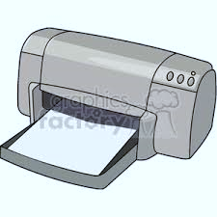


COMPUTER
Waits for Next Instructions
Hard Disc
Input Device
Secondary Memory
Output Device
Primary Memory

Slide 6
Application Types
Thick Client [Windows Application]
Thin client [Web Application]
Rich Internet Application [Smart Client]
Mobile Application [Mobile Client]
SAAS, PASS, IASS, etc..

Slide 7
Web Application

Slide 8





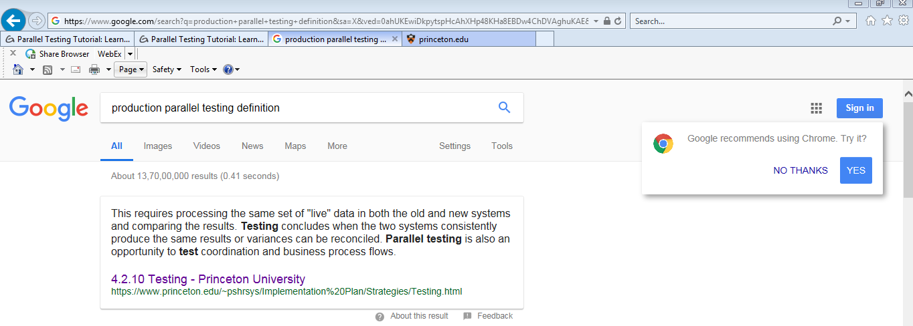





Introduction
“ Application program that is stored on a remote server and delivered over the Internet through a browser interface.”
Language
User /
Web browser
Web Server

Slide 9
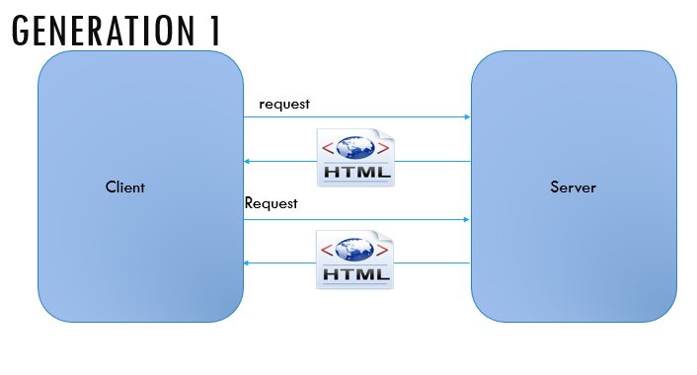
HTML Evaluation - Gen 1
“In first generation, client requests the server to get only static HTML page then renders the view in the client side[Browser]..”
Language

Slide 10
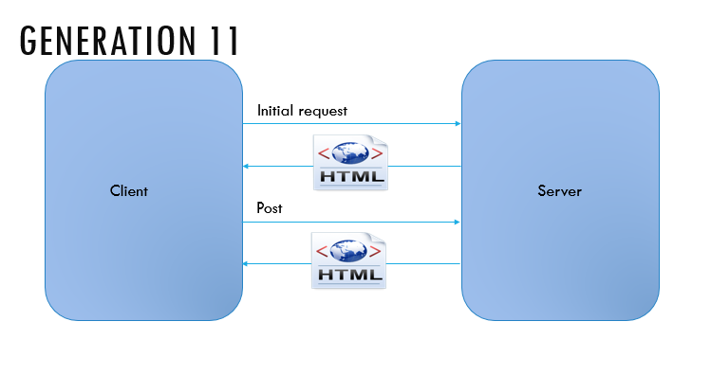
HTML Evaluation – Gen 2
“In second generation, server sends the HTML along with some state maintenance mechanism [Cookies] to retain the previous state of the user details. During every request, it sends back the HTML page and reload the view on each request.”
Language

Slide 11
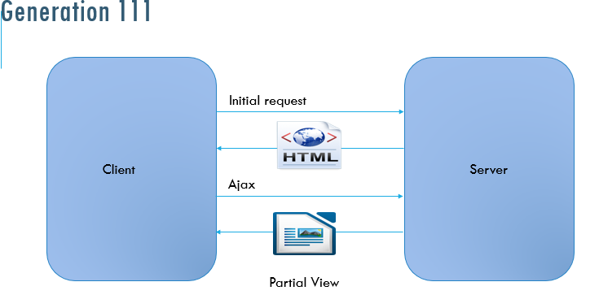
HTML Evaluation – Gen 3
“In third generation, instead of retrieving the whole page from the server repeatedly, load the page once and get the portion of the view from the server and render into the view as per the client demand.”
Language

Slide 12
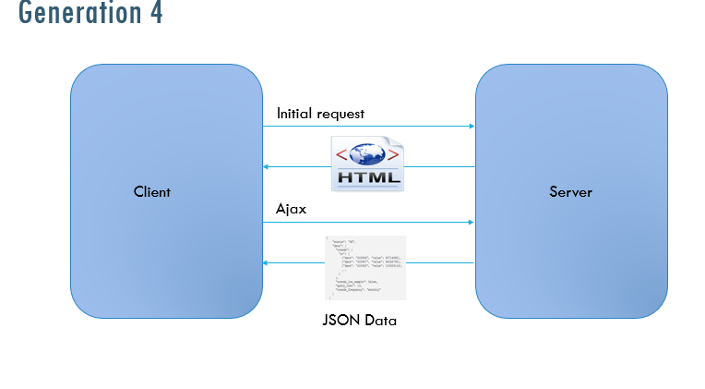
HTML Evaluation – Gen 4
“In fourth generation, load the page during the initial request. During subsequent requests, only the data/html will be got from the server and bind the value and fill the container in the client side. This approach will work like RCA (Rich client Approach). When we navigate from one page to another, the master page details will not be downloaded”
Language

Slide 13
HTML
(Hypertext markup language)

Slide 14
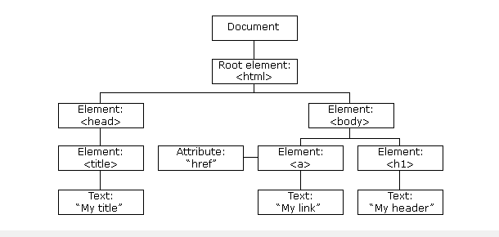
HTML DOM Structure
“Web browser creates the Document Object Model when the HTML Page loads.”
Language

Slide 15
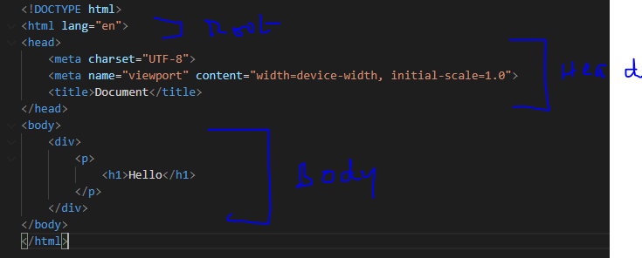
HTML DOM Structure

Slide 16
HTML Elements
Header
Paragraph
label
Text
Button

Slide 17
User Experience
Types
Inline
Page level
Element Level
Pattern
Specific
Custom

Slide 18
User Interaction
JavaScript
Page Level
Site level

Slide 19
Responsive Web Design
“Responsive web design makes your web page look good on all devices.”
Bootstrap
Materialize
Language

Slide 20
Thank you

